Slide 1
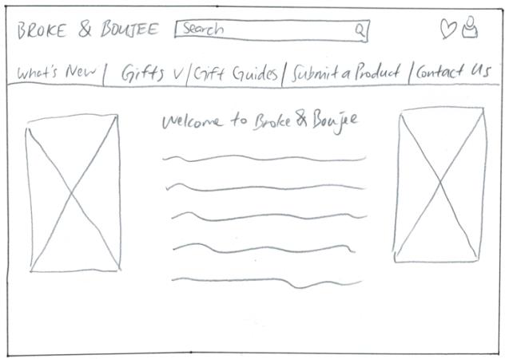
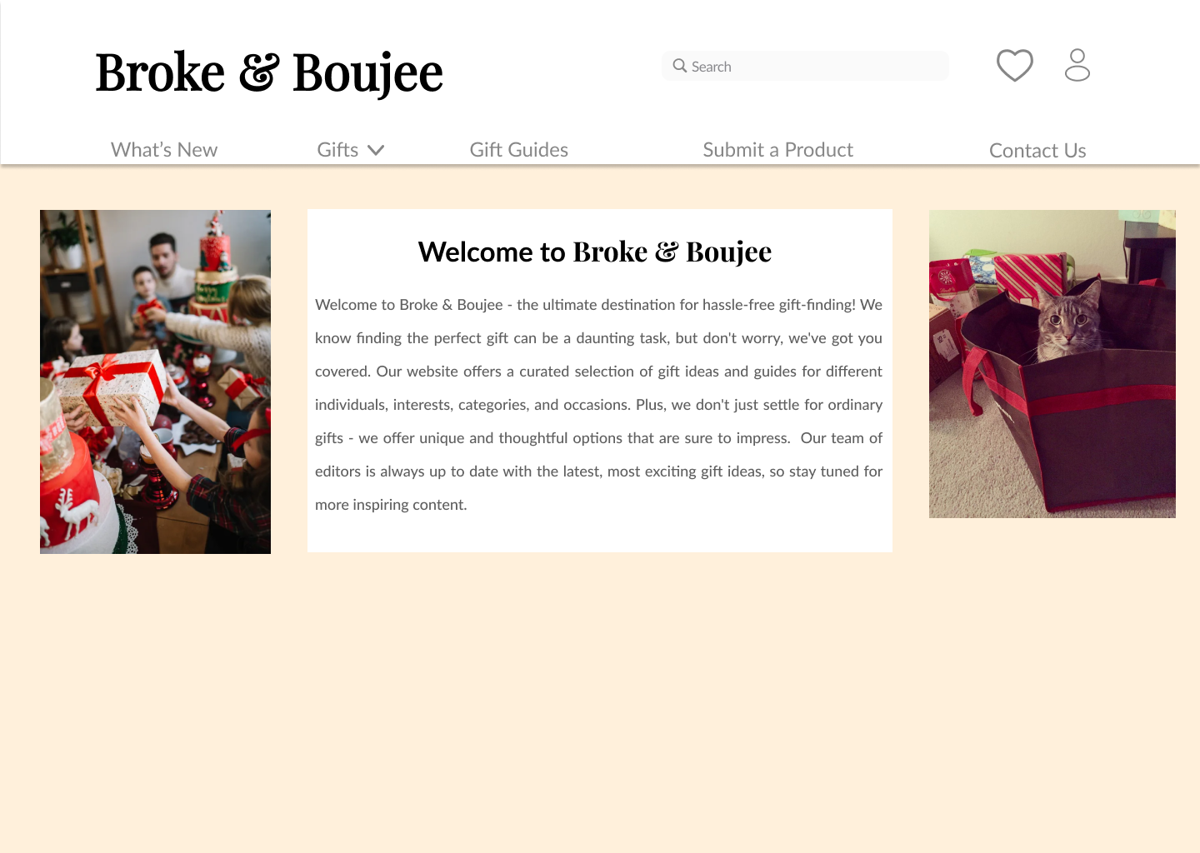
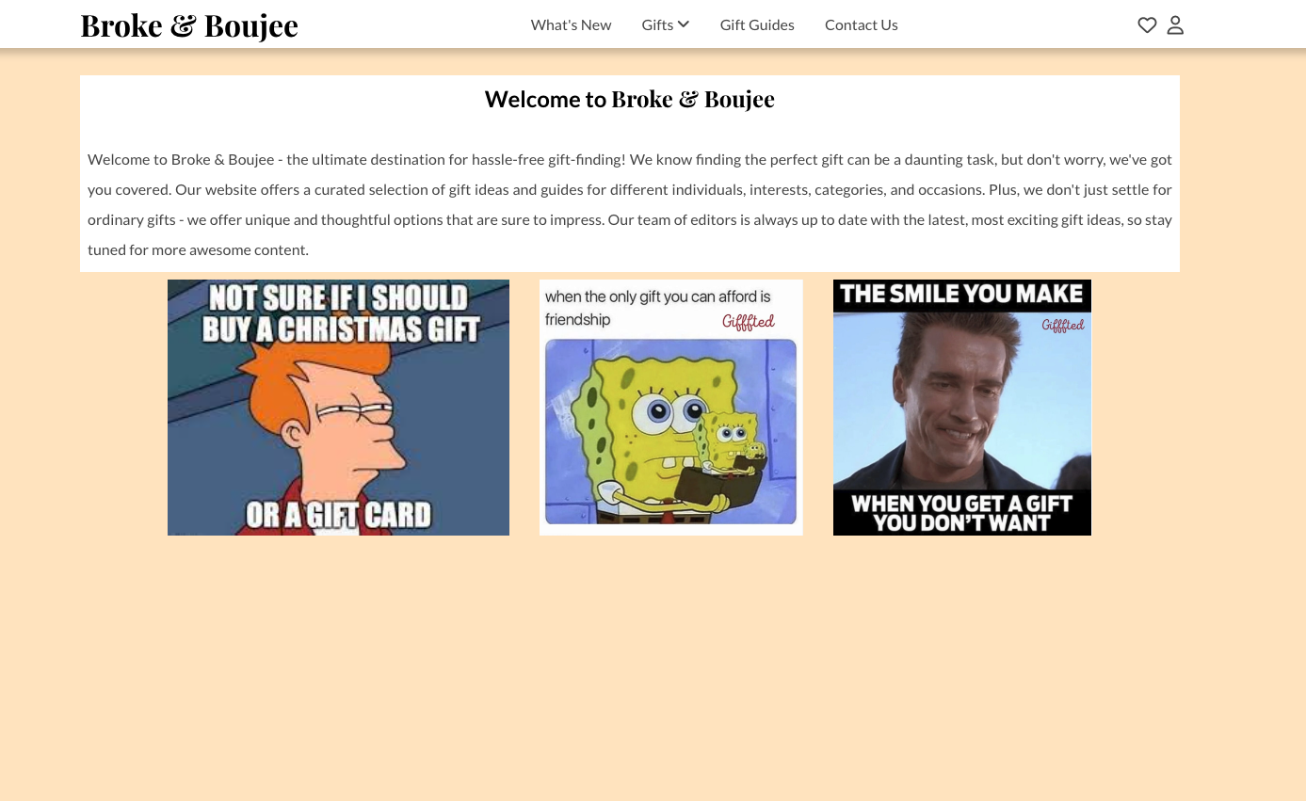
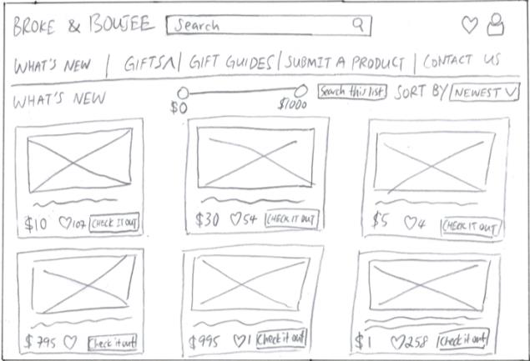
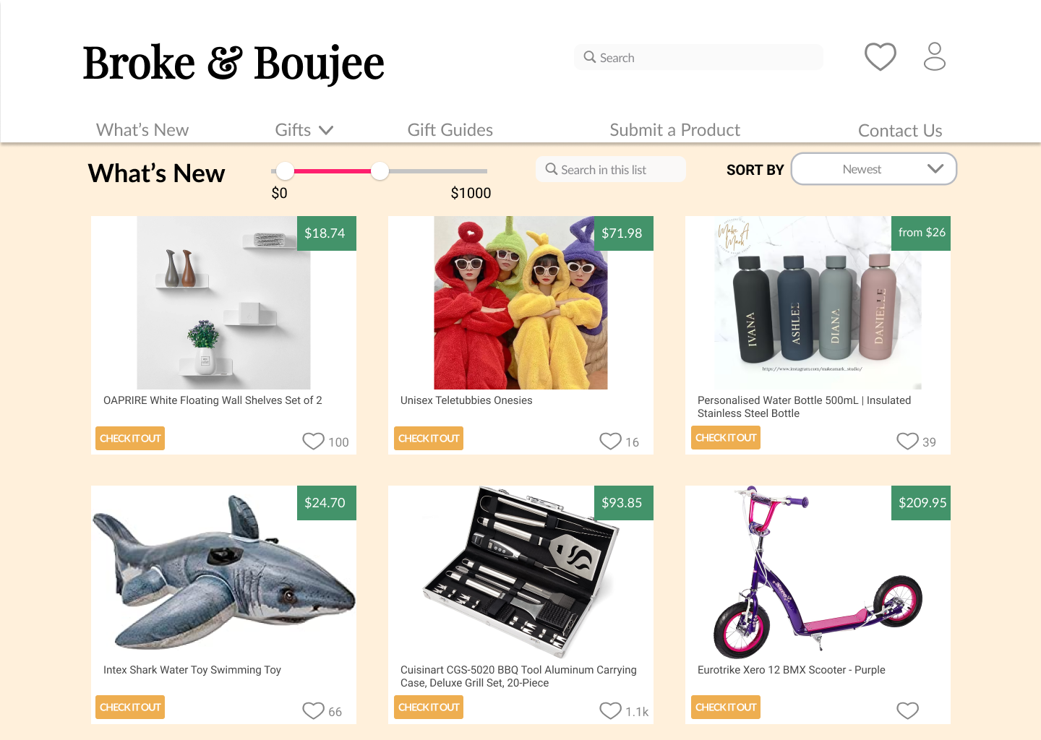
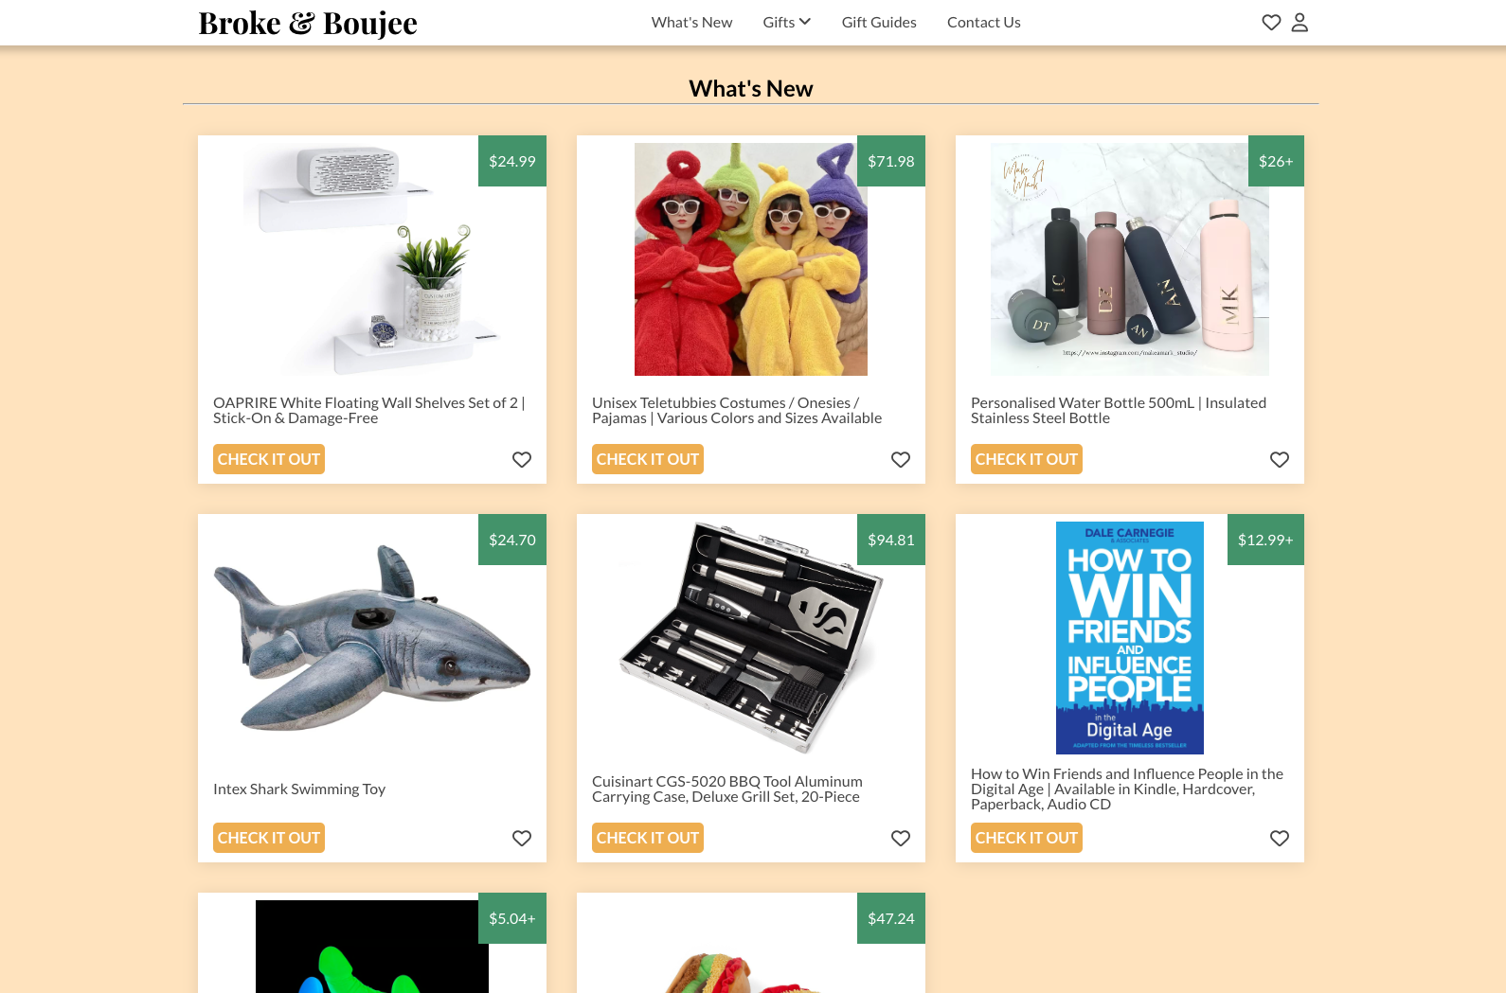
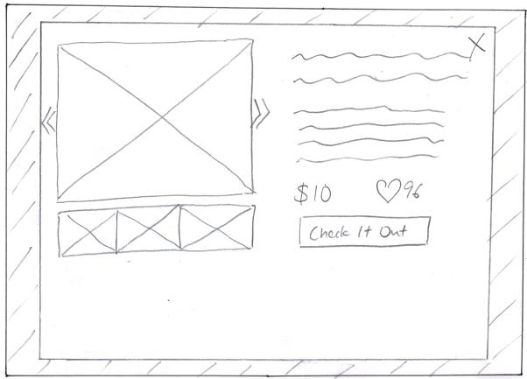
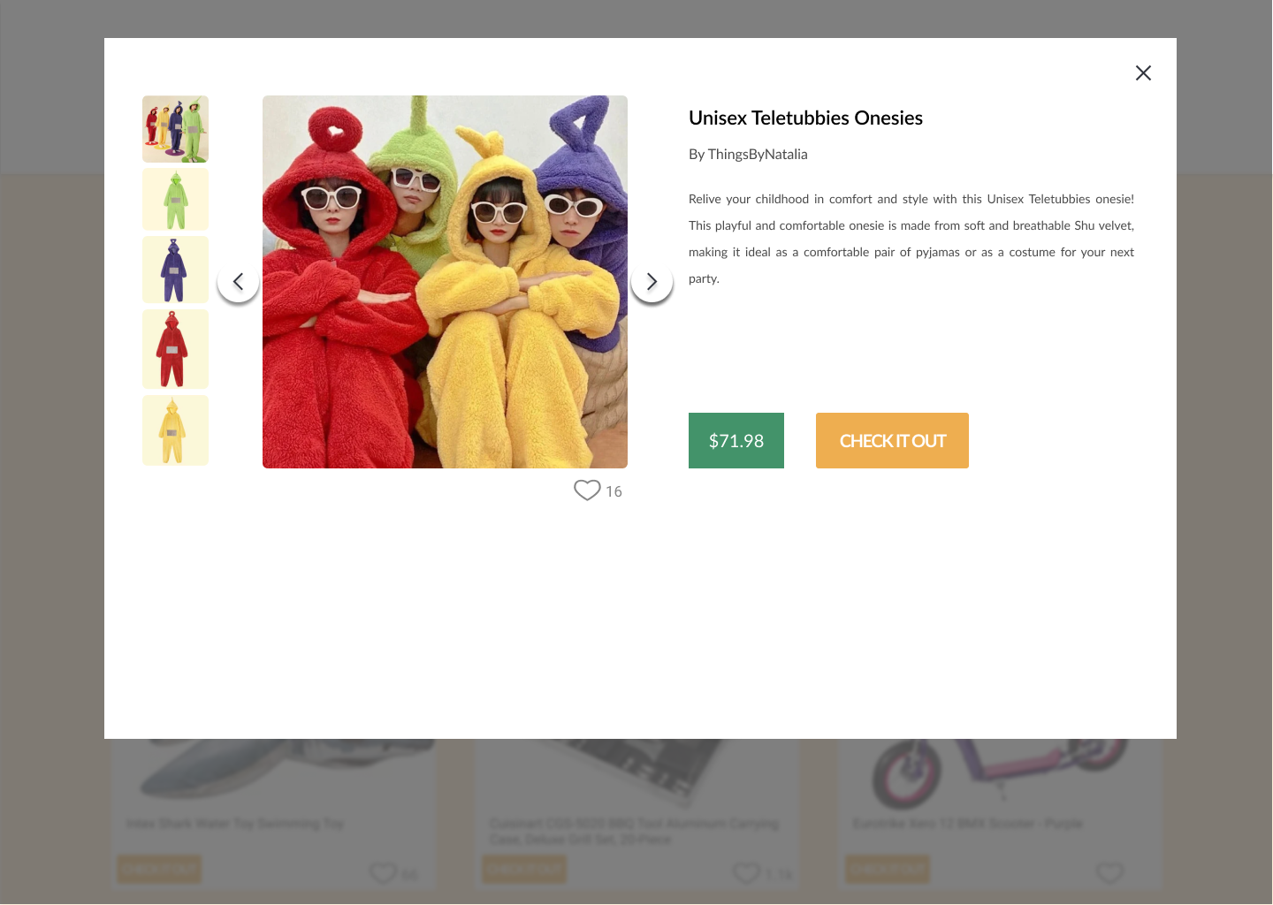
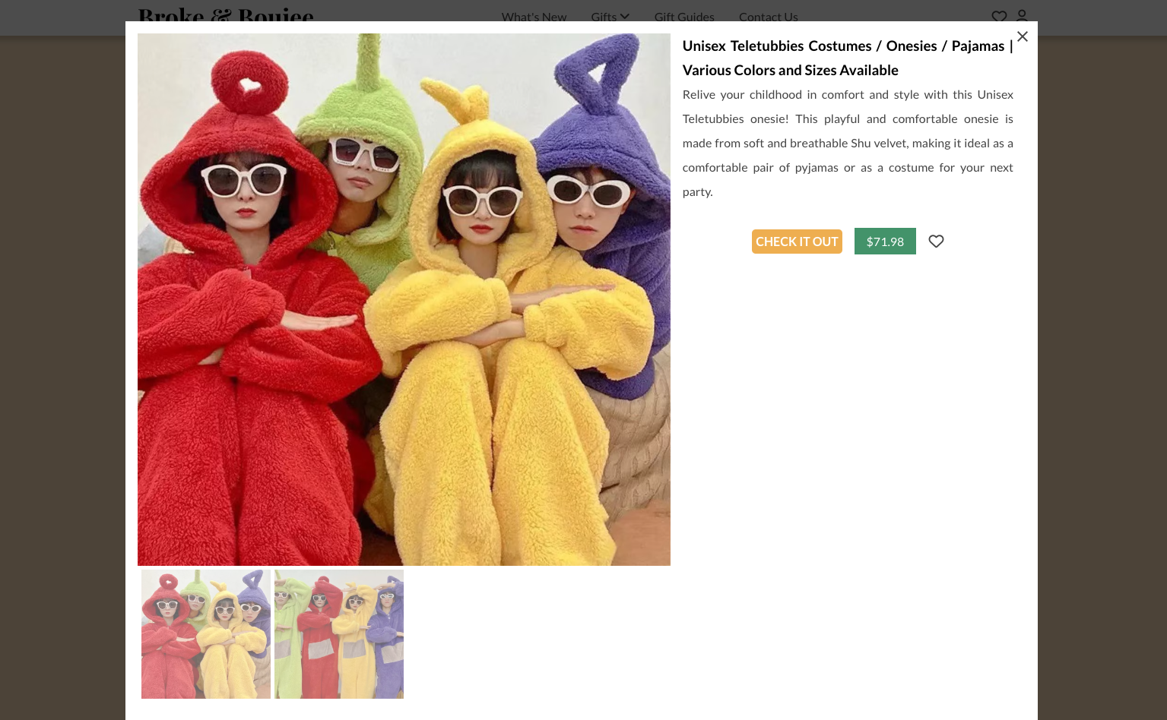
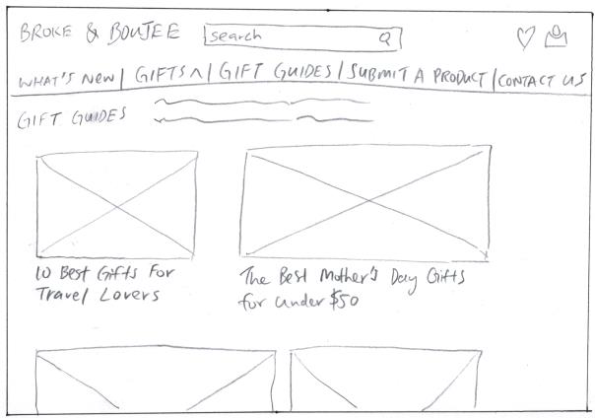
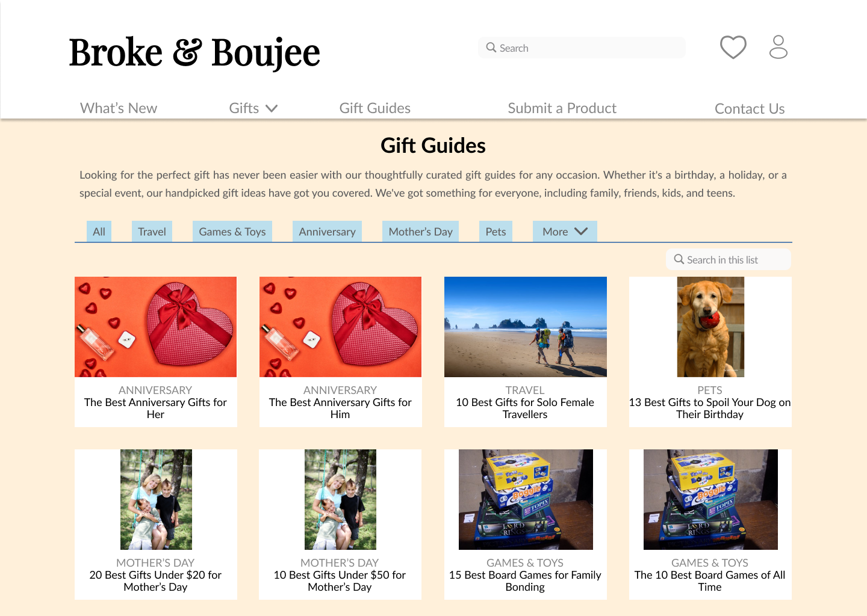
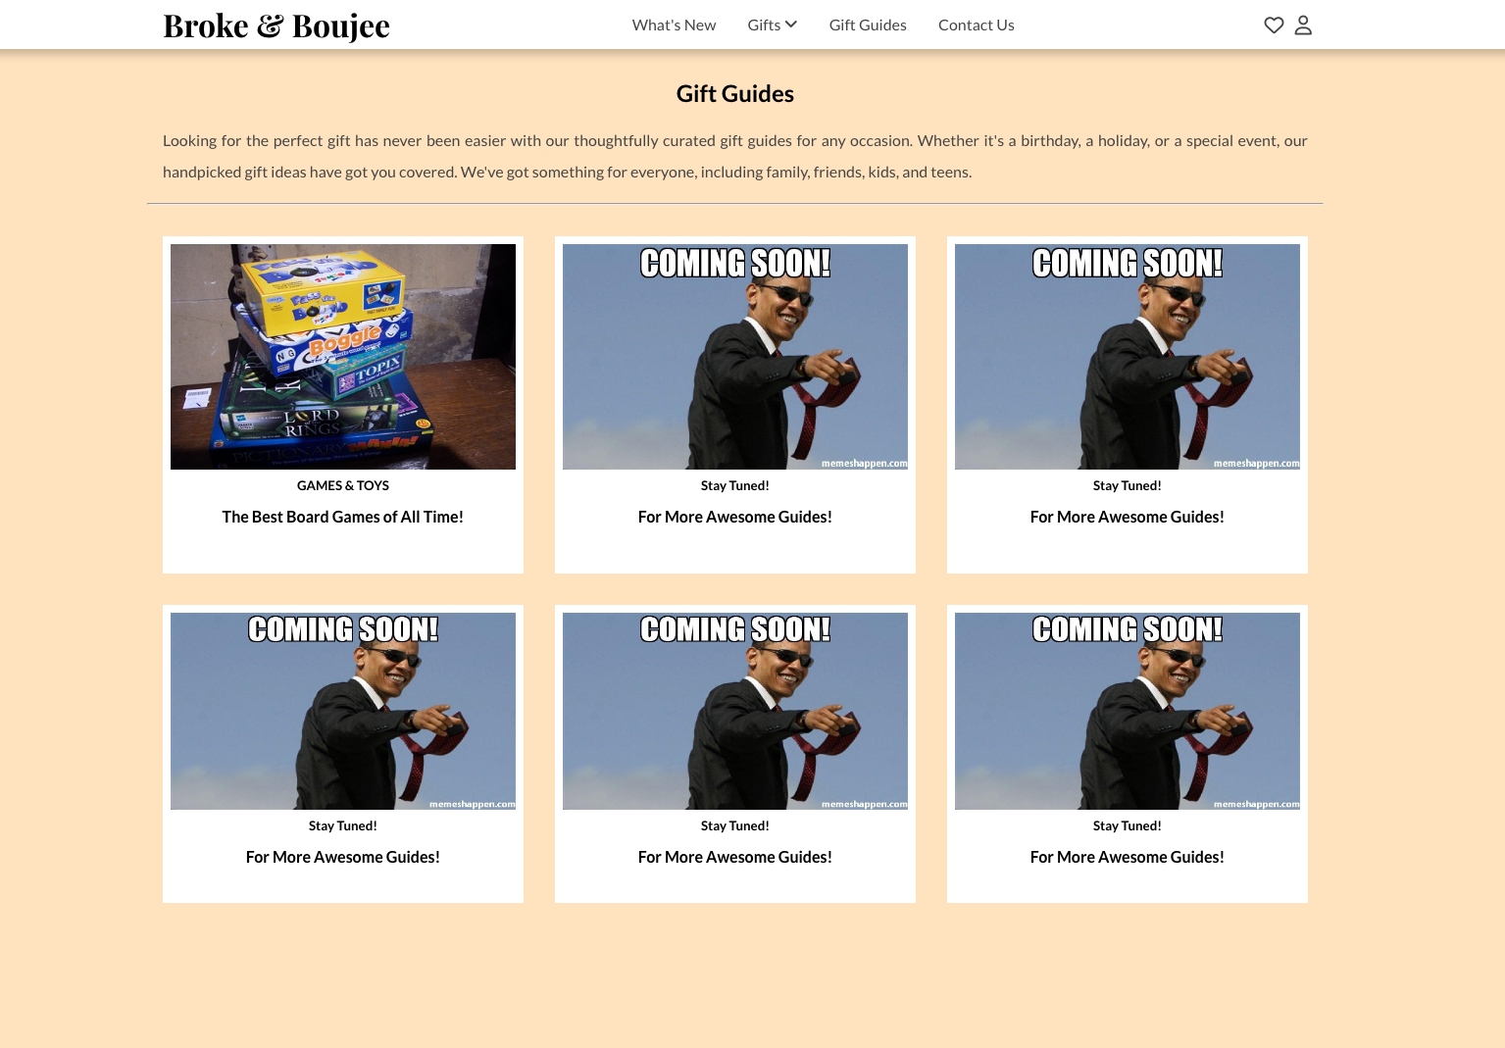
DECO1400 Web Implementation: Broke & Boujee
By Mark Zaine Chia (43161056)
INTRODUCTION
WEBSITE DESIGN: Low Fidelity Prototype → High Fidelity Prototype → End Product
JAVASCRIPT FUNCTIONALITY
Broke & Boujee is a gift finder website that offers a wide range of curated gift ideas and guides for different individuals, interests, categories, and occasions. Broke & Boujee does not stock nor sell any products to its users, rather it takes the user to affiliate websites. It caters to a broad audience, including busy professionals, parents, and geeks, among others. The goal of the website is to provide a hassle-free and enjoyable gift-finding experience to all its users.
After researching similar websites, I designed the prototype for Broke & Boujee first using hand sketches and then Figma, all while keeping Nielsen's 10 Usability Heuristics in mind. Below, you can see the progression from prototype designs to the final product, showcasing key pages/features of the website.
FOUR key Javascript functionalities include:
ADD/REMOVE TO/FROM WISHLIST - clicking the heart icon in the product or pop up boxes will add to wishlist, while clicking the remove will do the opposite. This feature uses localStorage so that the items in the wishlist remains even after refreshing page or restarting browser.
PRODUCT PREVIEW – clicking the product will open a preview (aka pop-up). This feature uses HTML data attributes to pair a product to the correct preview.
PRODUCT PREVIEW IMAGE CHANGER – in the preview, the user can browse more images by clicking the image and it will be featured at full size.
CONTACT US FORM VALIDATION - the form checks that the user has entered a valid email address and a message of at least 10 characters.
Landing Page
WEBSITE EVALUATION
The website met all but one of Nielsen’s 10 Usability Heuristics which was #9 – Helps user recognise, diagnose, and recover from errors. Key heuristics focussed on were:
#1 – Visibility of system status – by using hover effects when the user hovers over buttons, links or product boxes.
#4 – Consistency and standards – by ensuring each page has a consistent layout and functionality, and modelling the browsing experience to industry standards.
#8 – Aesthetic and minimalist design – by careful selection of colours, fonts, icons, and the use of pop-up windows.
Product Catalogue
Product Pop Up
FUTURE WORK / ENHANCEMENTS
If I had more time and/or knowledge, here are the list of things I would/would have implemented:
Search, sort, and filter function for products
Breadcrumbs navigation – especially important when there are more gift guides
Add footer with affiliate disclosures and social media links
Backend functionality – to handle sign ups/logins and store user data
Wishlist product preview/pop up – not fully functional at this point
REFLECTION
Key takeaways from the website implementation:
Be realistic with my prototype designs – My designs were far too complex and I had to cut back on a lot of features due to time constraints and skill limitations.
Think about responsive design right from the start – It was tremendously difficult to go back to my webpages to implement responsive design. Next time, I will start building websites with mobile in mind first!
Gift Guides

